Slide 1

Admission System For Pursuing Masters Abroad - Data Management for Analytics
BY
Venkatakrishnan Subramanian
Gayathri Dornadula
Group 3

Slide 2
Table of Contents
Aim of the Project
EER Diagram
UML Diagram
Mapping Conceptual Model to Relational
MySQL Query Implementation
RStudio Visualization

Slide 3
Aim of the Project
The objective of our study is to build a comprehensive admission database for pursuing master’s abroad. The database will consist of data pertaining to student’s profile, universities and courses offered, admits and rejects received by students, visa interviews, vaccinations and accommodation finalized by the students.
Through the creation of this database we aim to capture the most critical data that would suffice as a guideline for any prospective international student.

Slide 4
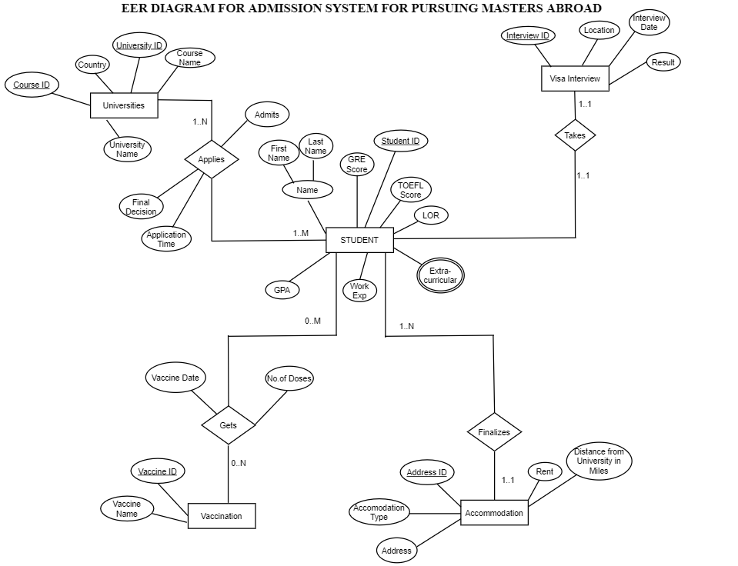
EER Diagram

Slide 5
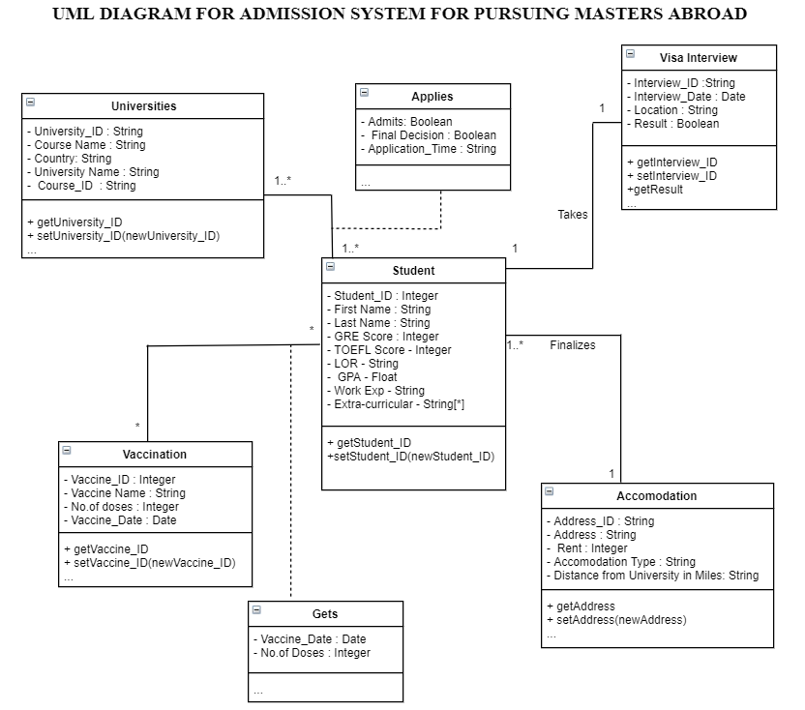
UML Diagram

Slide 6
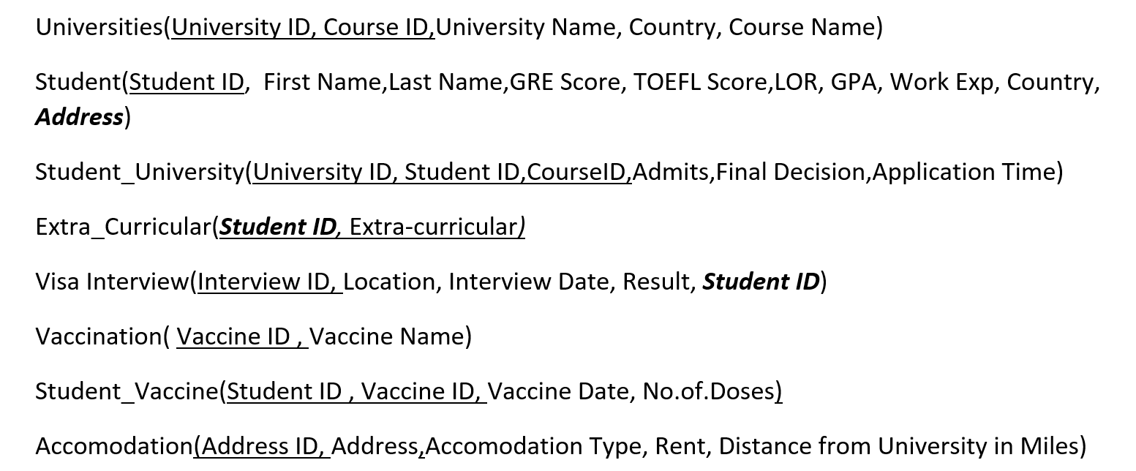
Mapping Conceptual Model to Relational Model

Slide 7
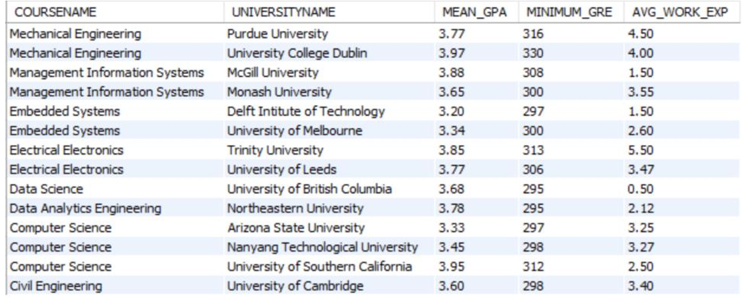
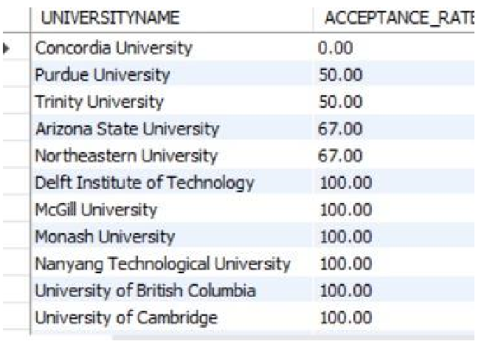
MySQL query Implementation

Slide 8
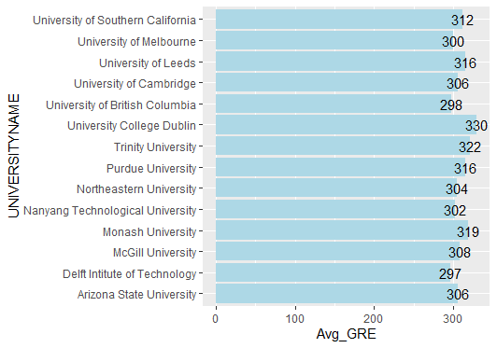
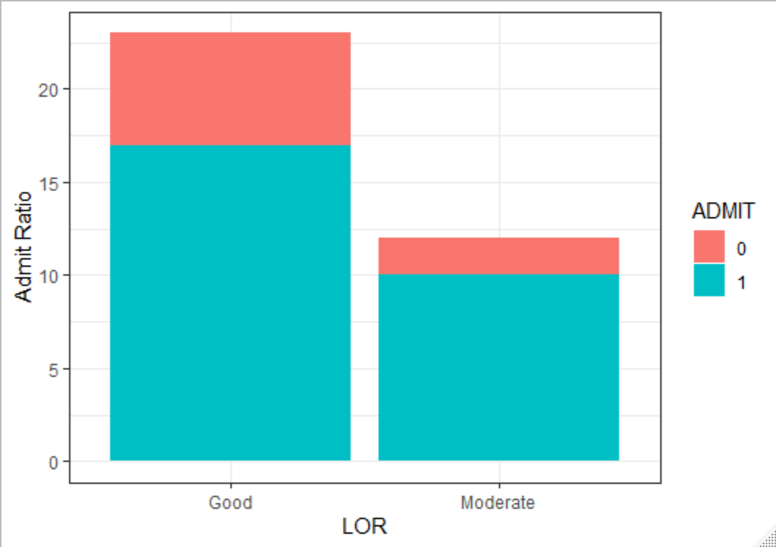
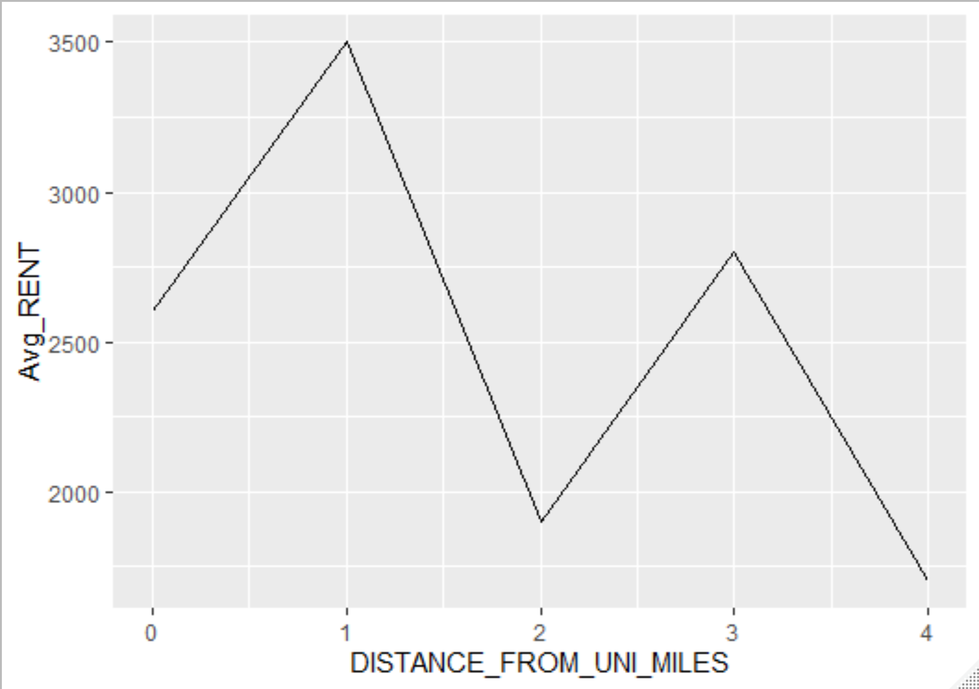
RStudio visualization

